Slide 1
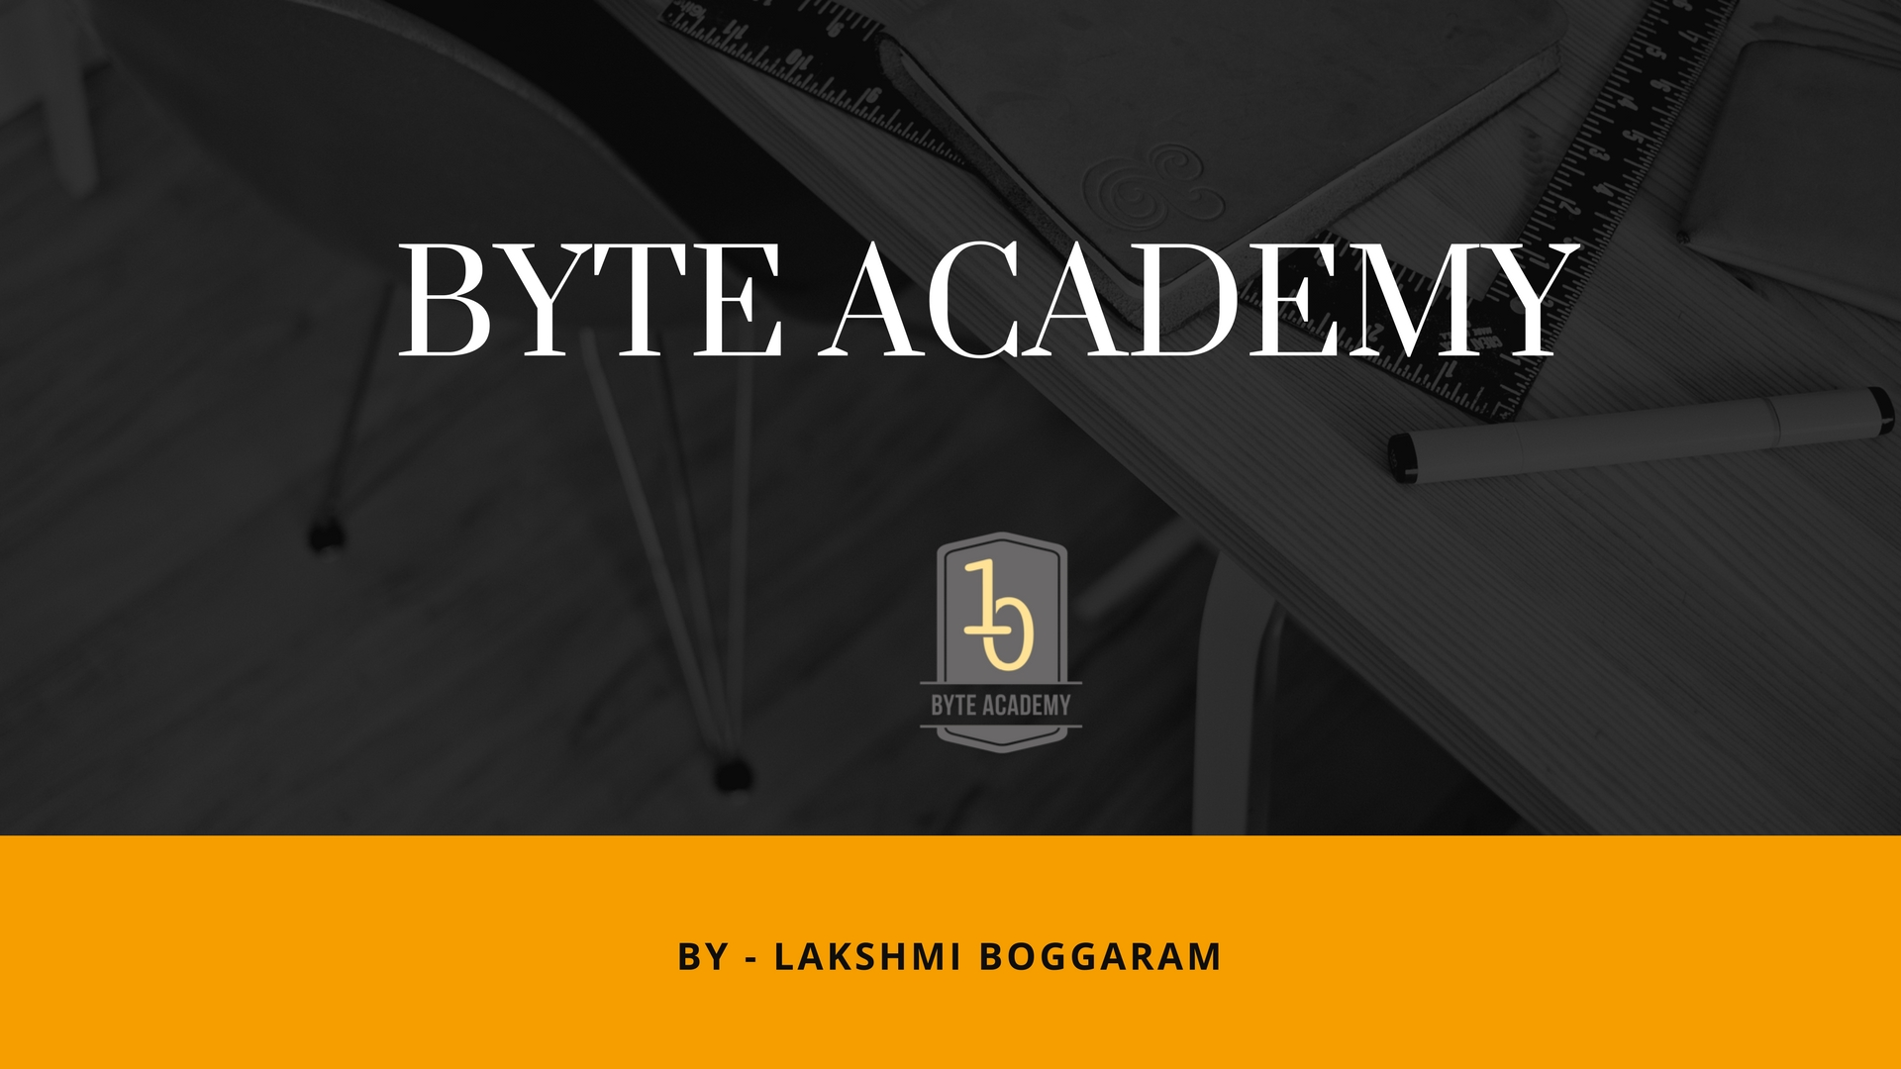

Slide 2
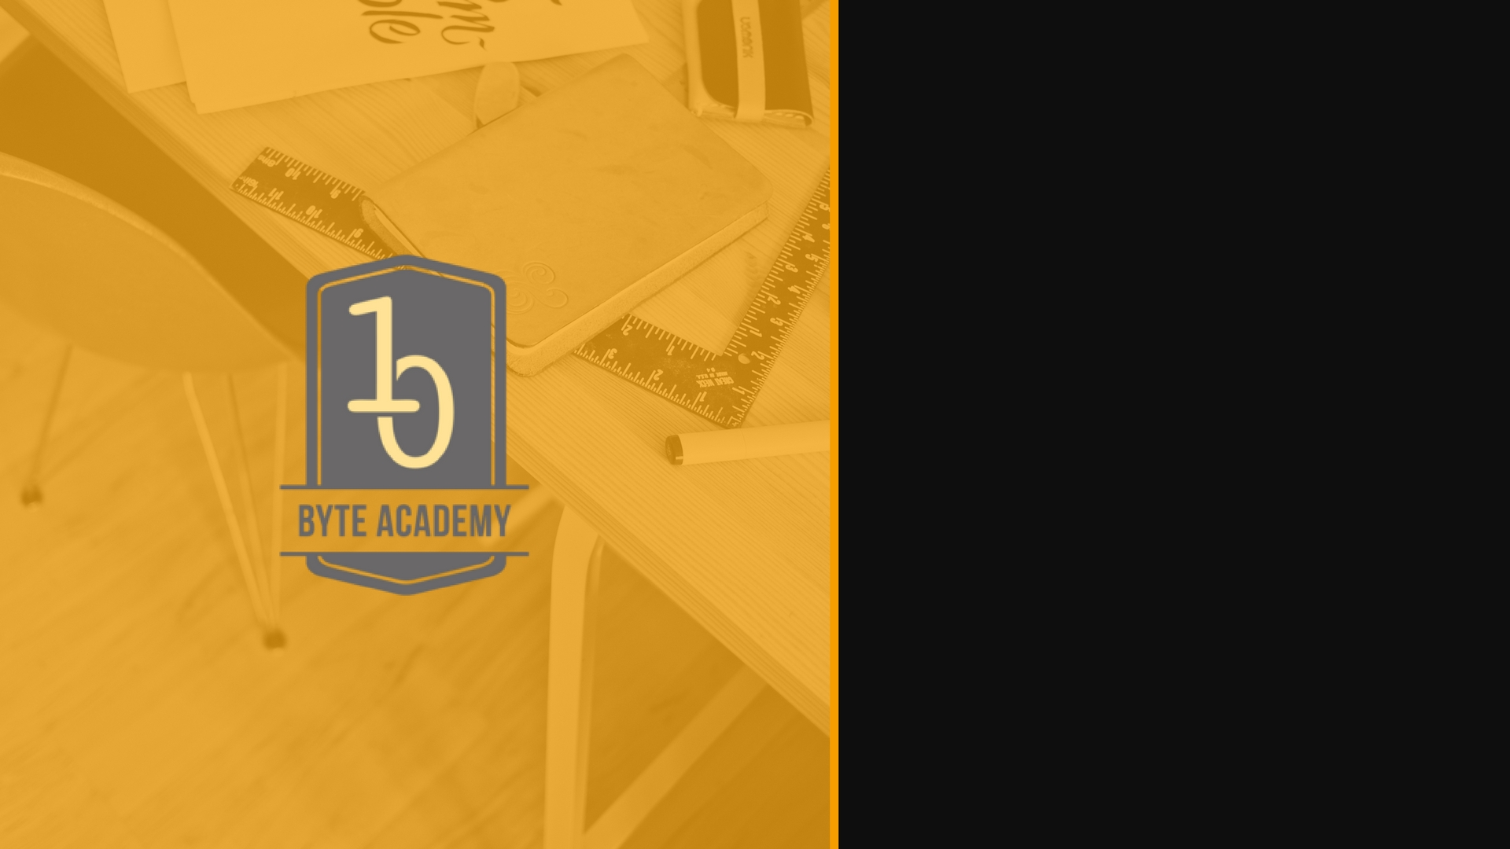
Introducing Python

Slide 3

Introducing Python
High Level Programming Language
Object Oriented Programming Language
Scalable through packaging modules
Extensible to other languages like C,C++
Portable
Easy to learn, more structured
Easy to Read
Easy to maintain
Robust
Interpreted and Byte Compiled

Slide 4
Origins of Python
Author – Guido Van Rossum
Started working in late 1989 in Netherlands University
He felt hard with c,c++, java and lisp in getting the jobs done
Wrote something simple, and more close to human readability and get the job done in more simpler way than its predecessors language like c, c++
Robust memory management

Slide 5
Python Installation
Install Python
Learning the help
Pip installation manager
Official Documentations – http://docs.python.org/3
Reference Books
Reference Video Playlists
Github Repo

Slide 6
Python Video Reference Playlists
MIT OCW – Introduction to CS by Dr. Ana Bell
https://ocw.mit.edu/courses/electrical-engineering-and-computer-science/6-0001-introduction-to-computer-science-and-programming-in-python-fall-2016/
YouTube Dr. Ana Bell Videos
https://www.youtube.com/watch?v=ytpJdnlu9ug&list=PLUl4u3cNGP63WbdFxL8giv4yhgdMGaZNA
YouTube Videos – Corey Schafer
https://www.youtube.com/channel/UCCezIgC97PvUuR4_gbFUs5g

Slide 7


